Slide 1
Numpy – Handling Matrices
Prof. Yong Won SEO, Ph.D.
College of Business and Economics
Chung-Ang University

Slide 2
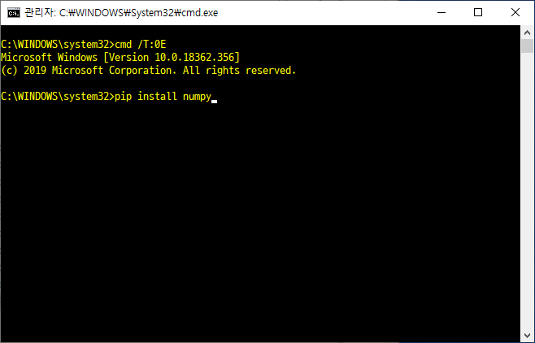
install numpy

Slide 3
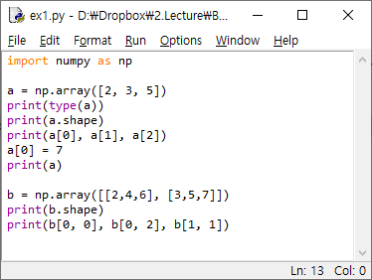
Creating a matrix (2-dimensional array)

Slide 4
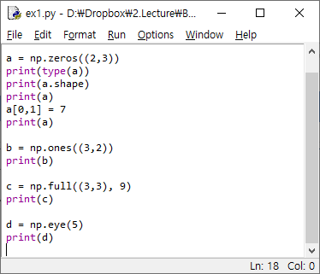
Various methods to create matrices

Slide 5
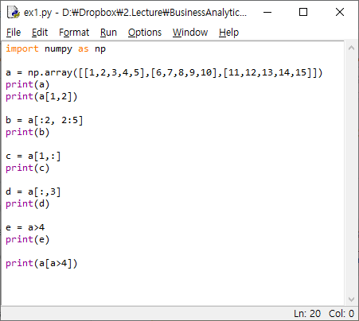
Indexing matrices

Slide 6
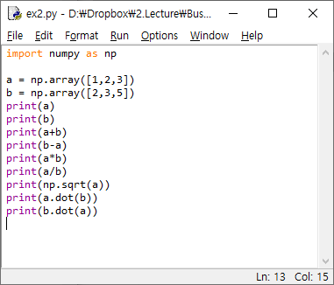
Calculations

Slide 7
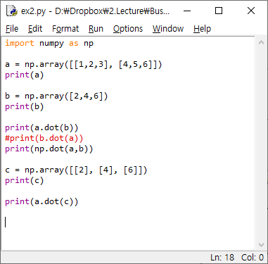
Calculations (cont)

Slide 8
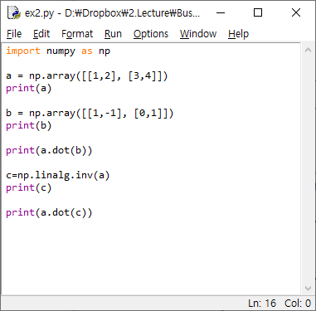
Calculations (cont)

Slide 9
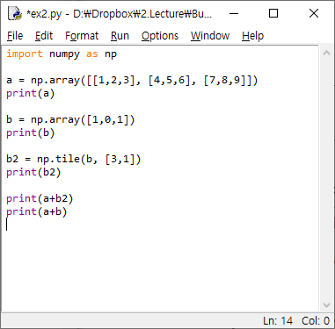
Tile and broadcasting

Slide 10
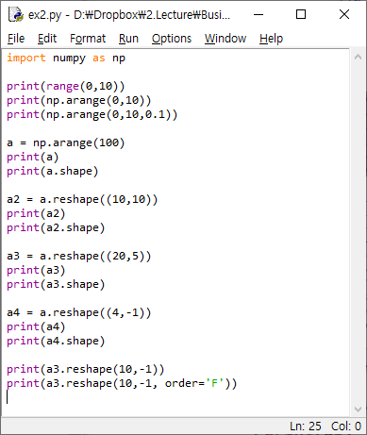
Reshape

Slide 11
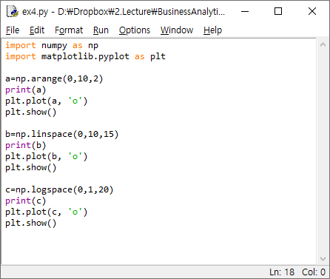
Creating data

Slide 12
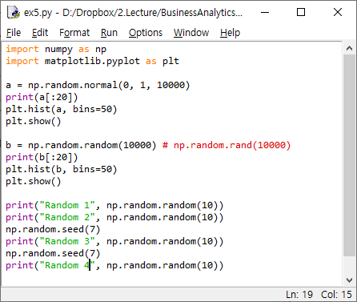
Random numbers

Slide 13
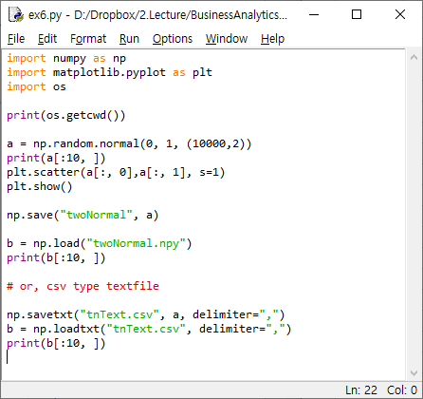
Save and Load

Slide 14
Various functions
https://docs.scipy.org/doc/numpy/reference/routines.statistics.html

